Slide 1

Automatic Attendance Marker
Department of computer Science
Guide – Prof. Amit Sanger
Presented by-
Sparsh Verma
(2000290120164) CS-7C
Shaurya Awasthi
(2000290120142) CS-7C
Tushar Sharma
(2000290120177) CS-7C

Slide 2
Problem Statement
In educational institutions and workplaces, the process of manually taking attendance is time-consuming, error-prone, and often inefficient. This project aims to develop an automated system that utilizes face recognition technology to streamline and improve the attendance tracking process.

Slide 3






Agenda
Introduction
Objective
Methodology
Overview
Project Highlights
Summary

Slide 4
Introduction
Attendance maintenance is a significant function in all the institutions to monitor the performance of the students.
Some of these institutes use the old paper or file-based systems and some have adopted strategies of automatic attendance using some biometric techniques.
A facial recognition system is a computerized biometric software which is suited for determining or validating a person by performing comparison on patterns based on their facial appearances.
Face recognition for the intent of marking attendance is a resourceful application of attendance system.
It is widely used in security systems, and it can be compared with other biometrics such as fingerprint or eye iris recognition systems.

Slide 5
Objective
So, this face recognition model helps to mark attendance more accurately and effectively which reduces the time consumption and the hectic maintenance of daily records of attendance
The main objective to create this application and model which reduce the time consumption and difficulty in maintaining records .
This model can be reliable system to mark attendance without any proxy.

Slide 6
Methodology
Automatic Attendance Marker is a model and web or android Application that helps in marking attendance. It takes less time than the traditional attendance marking system.
IMAGE PROCESSING
FEATURE EXTRACTION
FACE RECOGNITION
IMAGE CLUSTERING
TECHNOLOGY DESCRIPTION
OpenCV
Pandas
HTML,CSS,JS,Flask
Microsoft Excel

Slide 7
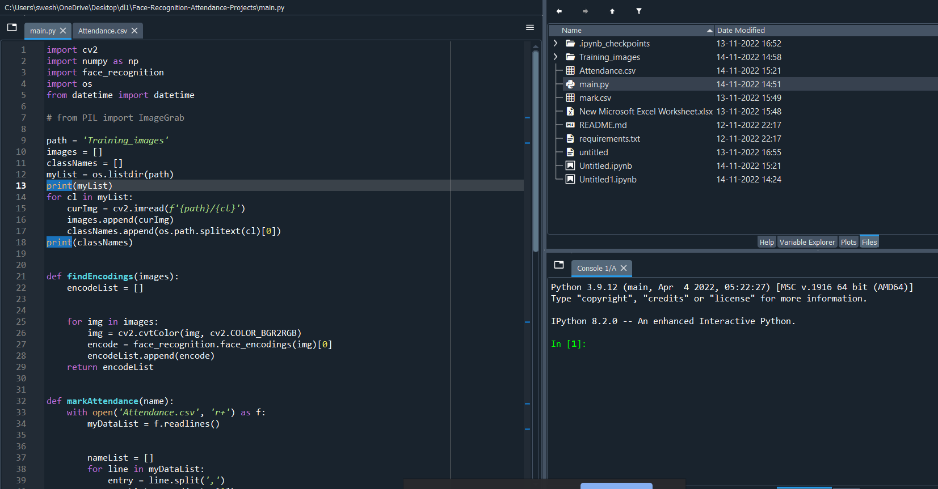
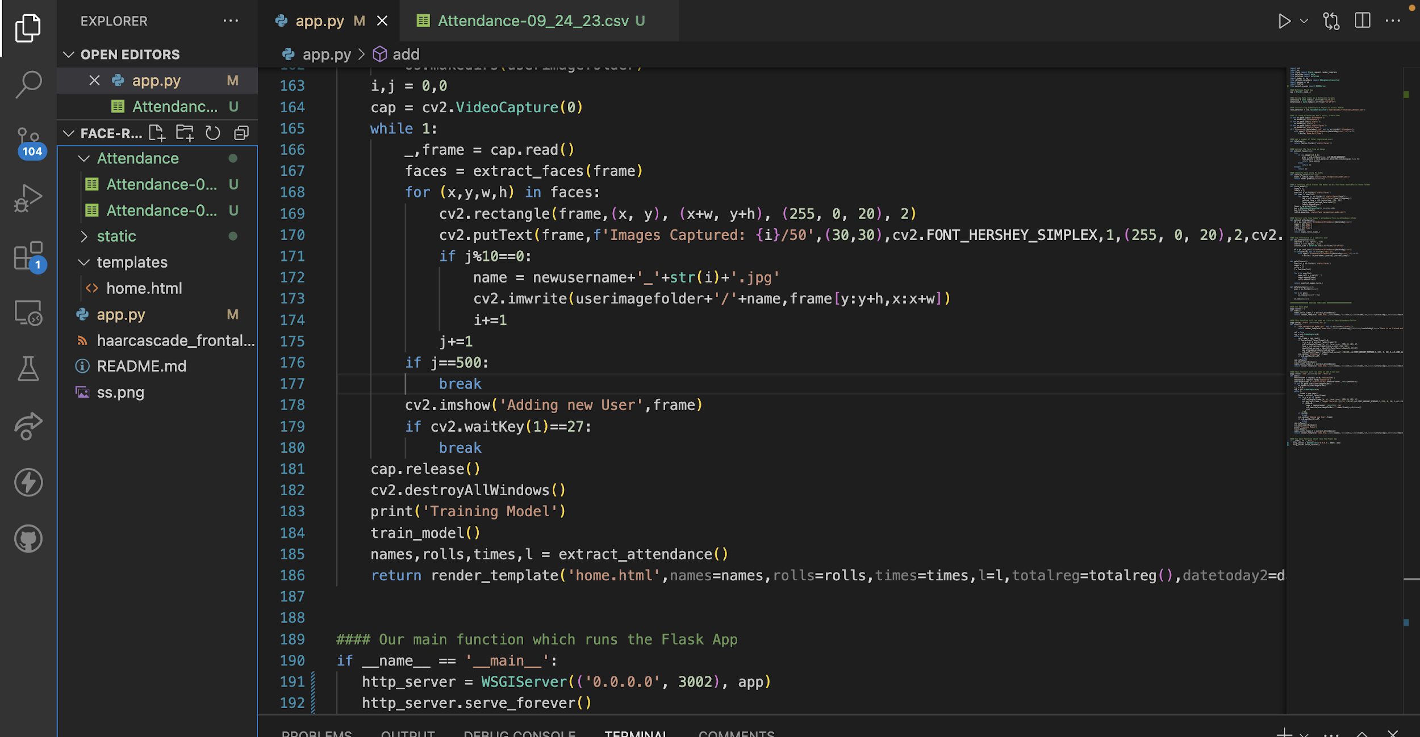
OVERVIEW
In this project Model the attendance of the class students will be marked automatically , by using live video in which multiple faces will be detected at the same time and will be recognized by the prestored dataset and finally the attendance will be marked .
MODEL

Slide 8
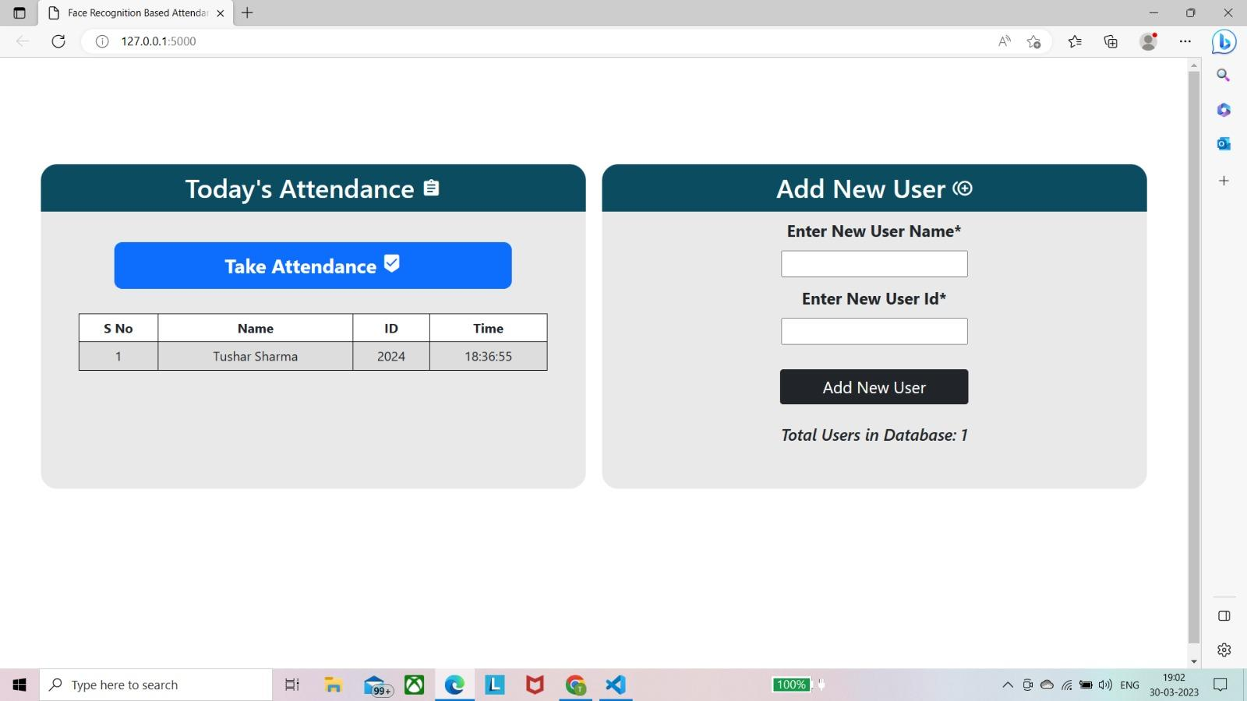
FRONTED OVERVIEW
3/30/2023
PRESENTATION TITLE

Slide 9
Literature Survey
References | Year | Model Used | Data Set used | Major Contribution | Results
1 | 2023 | Image recognition using Machine learning | Cat and dog Images | Image recognition KNN | Image Clustering and Recognition.
2 | 2023 | Deep Learning for Practical Image Recognition: | Source : Research Paper Data Set. | Recognition of face | It propose a computational deep learning framework used for image recognition
3/30/2023
PRESENTATION TITLE

Slide 10
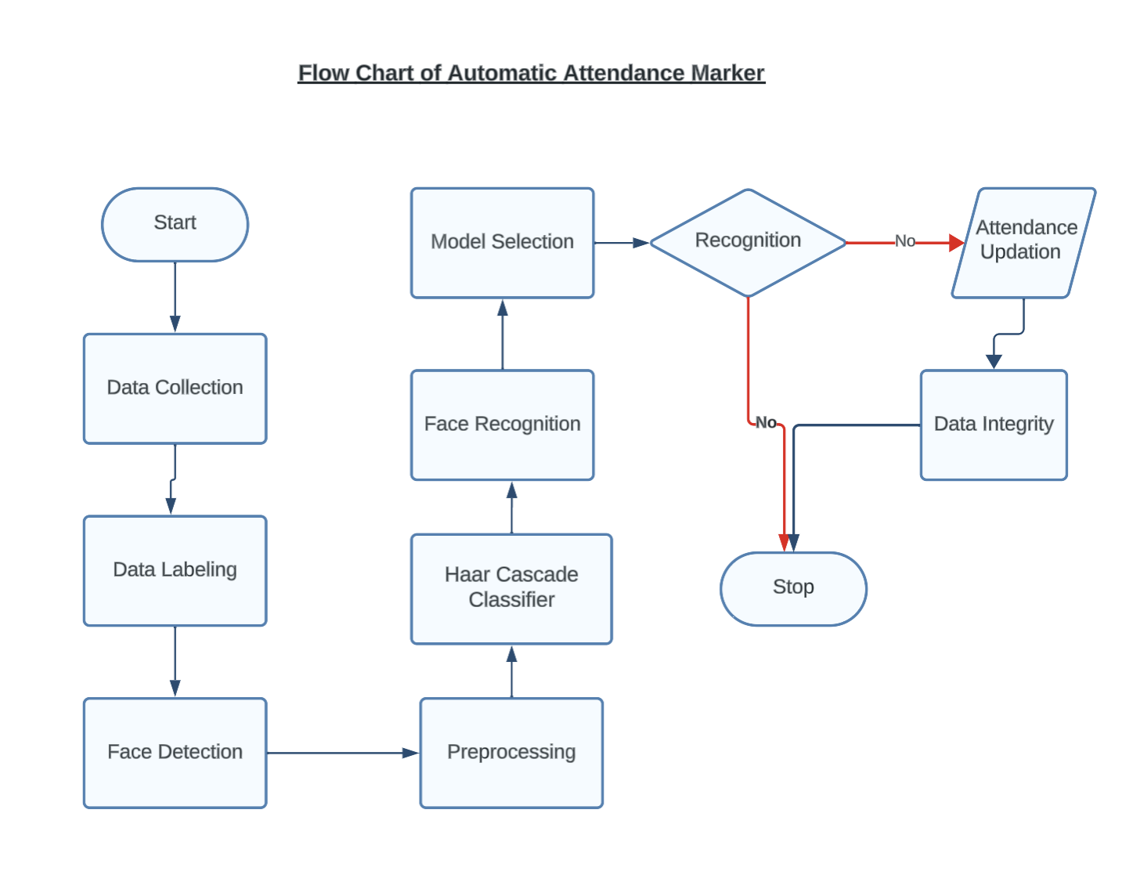
Project Diagram
Flow Chart Diagram

Slide 11
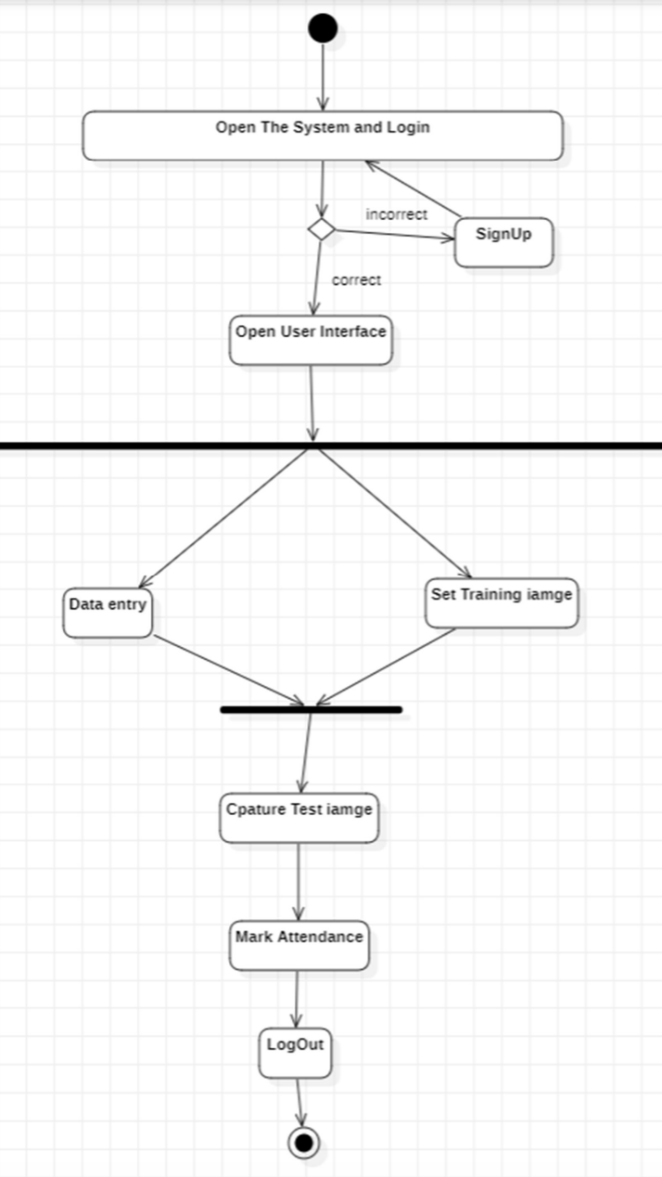
Project Diagram
Activity Diagram

Slide 12
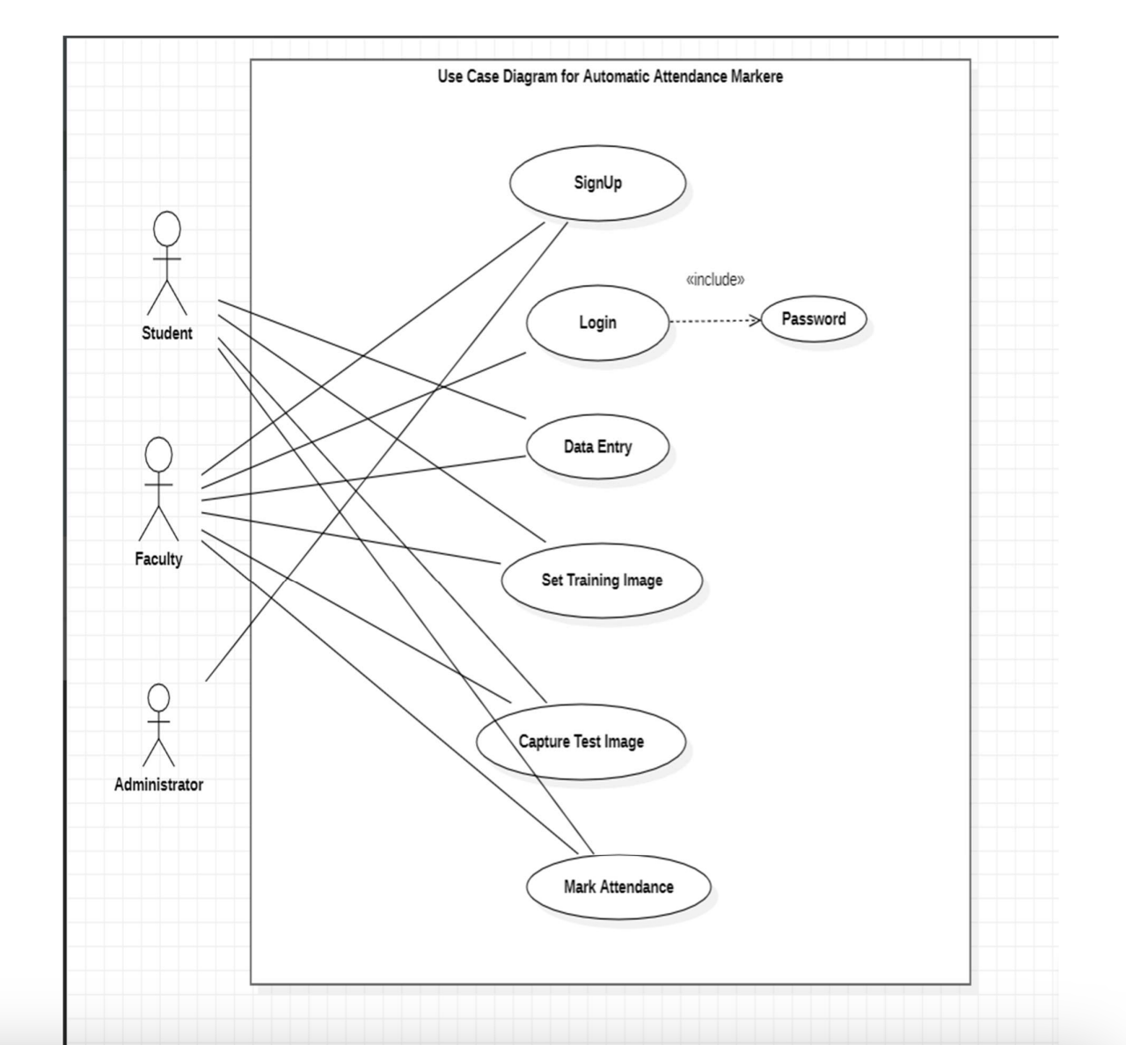
Project Diagram
Use Case Diagram

Slide 13
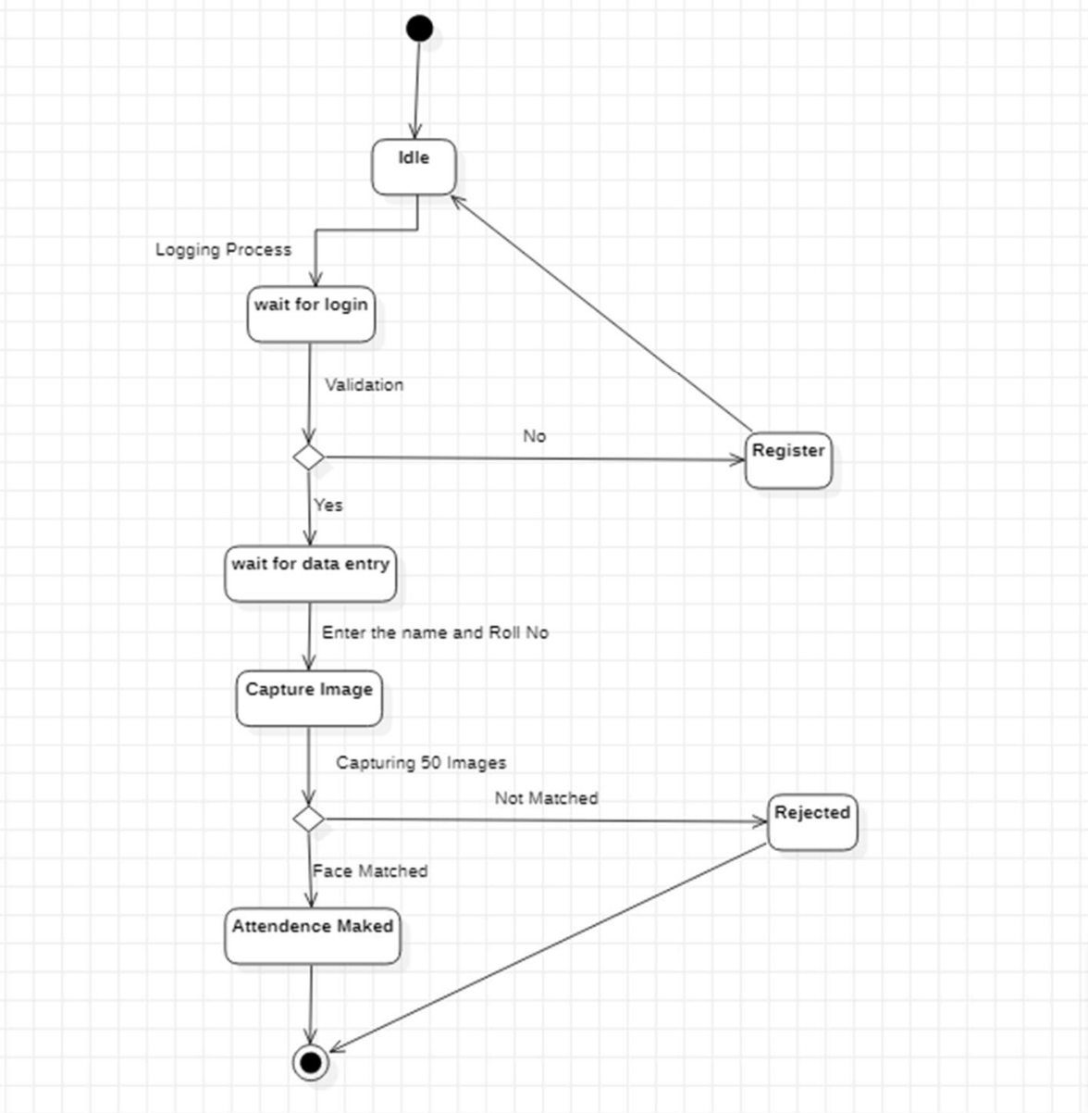
Project Diagram
State chart diagram

Slide 14
Patent Status:
~Published

Slide 15
Research Paper Status:
~Applied in the conference

Slide 16
Project Status
100% percent completed

Slide 17
References
Research Paper: Image recognition using Machine learning Authors: Abhinav N Patil B tech student, Dept of S&T, Vishwakarma University
Research Paper on- Deep Learning for Practical Image Recognition Authors: Li Wang Institute for Infocomm Research wang_li@i2r.a-star.edu.sg
3/31/2023
PRESENTATION TITLE
‹#›

Slide 18
End Users:
Faculty Staff: Faculty Staff can use Automatic Attendance marker applications for taking attendance of the student with more accuracy in short span of time. The chances of error in this nearly tend to 0%, providing reliable information to the faculty.
Students: In this project Model the attendance of the class students will be marked automatically, by using live video in which multiple faces will be detected at the same time and will be recognized by the restored dataset and finally the attendance will be marked.
Organization And Institutions: Automatic Attendance Markers can solve the various hectic process of traditional methods of taking attendance at different – different places of organization and educational institutions. It also contributes to the growth of the culture of modern education with innovative technologies like machines and deep learning.
3/30/2023
PRESENTATION TITLE

Slide 19
Summary
The main goal and objective of this automated attendance system of face detection and recognition is to present face recognition in real time environment for educational institutes or an organization to see and mark the attendance of their students and employees on a daily basis to keep track of their presence. The system will mark and record the attendance in any environment. This system is purely automated and user can capture video and accordingly attendance will be marked, improving the accuracy to great extent and finally the attendance report will be generated.
3/30/2023
PRESENTATION TITLE

Slide 20
Thank you
Presented by-
Sparsh Verma
(2000290120164) CS-7C
Shaurya Awasthi
(2000290120142) CS-7C
Tushar Sharma
(2000290120177) CS-7C

